Slide 1
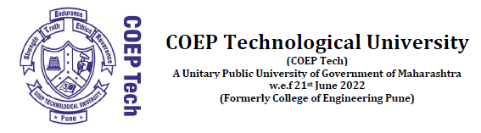
PLAGIARISM DETECTION AND REPORTING SYSTEM
A proposal for the COEP Technological University Hackathon by Team V6
Abhijeet Jadhav – 612203071 Aaryan Tokekar – 612211001 Kapil Tangsali – 612203177
Yash Pawar – 612203142 Soham Vaze – 612203187 Tanmayi Sulakhe - 612203173
COEP Technological University
A Unitary Public University of Govt. of Maharashtra
Formerly College of Engineering Pune

Slide 2
PLAGIARISM DETECTION AND REPORTING SYSTEM (PDRS)
Approach with respect to the Problem Statement
PDRS is designed to detect plagiarism in a large volume of files submitted to it on top of a pre-existing database
Capable of cross-referencing a batch of files within themselves for plagiarism but also references them against several online sources
It provides a comprehensive report to a user which is customizable and save-able for future references
COEP Technological University
A Unitary Public University of Govt. of Maharashtra
Formerly College of Engineering Pune

Slide 3
PLAGIARISM DETECTION AND REPORTING SYSTEM (PDRS)
Tech Stack Overview
Flask: Lightweight web framework for building scalable web applications.
SQLAlchemy: Python SQL toolkit and Object-Relational Mapping (ORM) library for database management.
HTML-CSS: Markup and styling languages for creating structured and visually appealing web pages.
JavaScript: Versatile scripting language for adding interactivity and dynamic content to web applications.
Python: High-level programming language known for its simplicity and versatility, used for backend logic and effective file processing tasks
Selenium: A robust automated testing framework, augments our tech stack, enabling us to bypass OpenAI API
COEP Technological University
A Unitary Public University of Govt. of Maharashtra
Formerly College of Engineering Pune

Slide 4
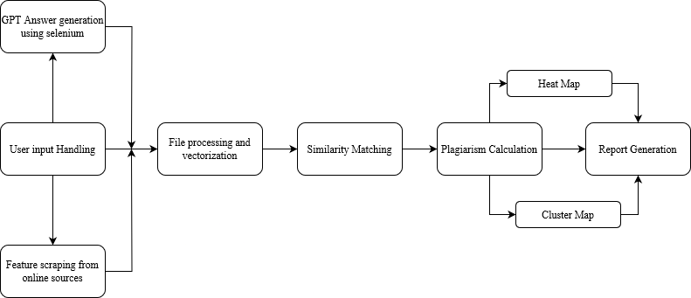
PLAGIARISM DETECTION AND REPORTING SYSTEM (PDRS)
Implementation and Algorithm Design
COEP Technological University
A Unitary Public University of Govt. of Maharashtra
Formerly College of Engineering Pune

Slide 5
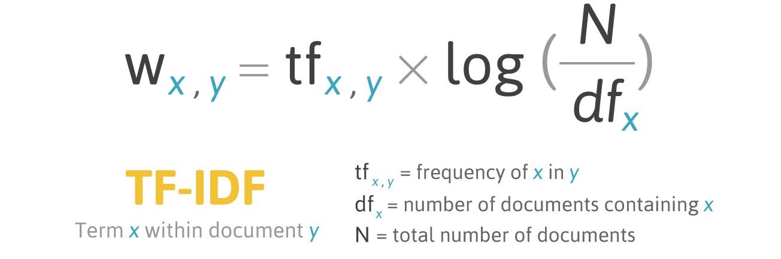
PLAGIARISM DETECTION AND REPORTING SYSTEM (PDRS)
Algorithm for better Plagiarism Calculation
Our algorithm is a self developed algorithm largely based on Cosine Similarity
It improves upon the effectiveness of calculating Cosine Similarity between two vectors by including multiple words (bigrams) for a single value in the Term Frequency – Inverse Document Frequency calculation
TF-IDF Vectorization helps us to understand the relevance of a document’s feature words relative to the whole corpus
By including bigrams we can identify semantic relationships between words and identify important phrases in documents
COEP Technological University
A Unitary Public University of Govt. of Maharashtra
Formerly College of Engineering Pune

Slide 6
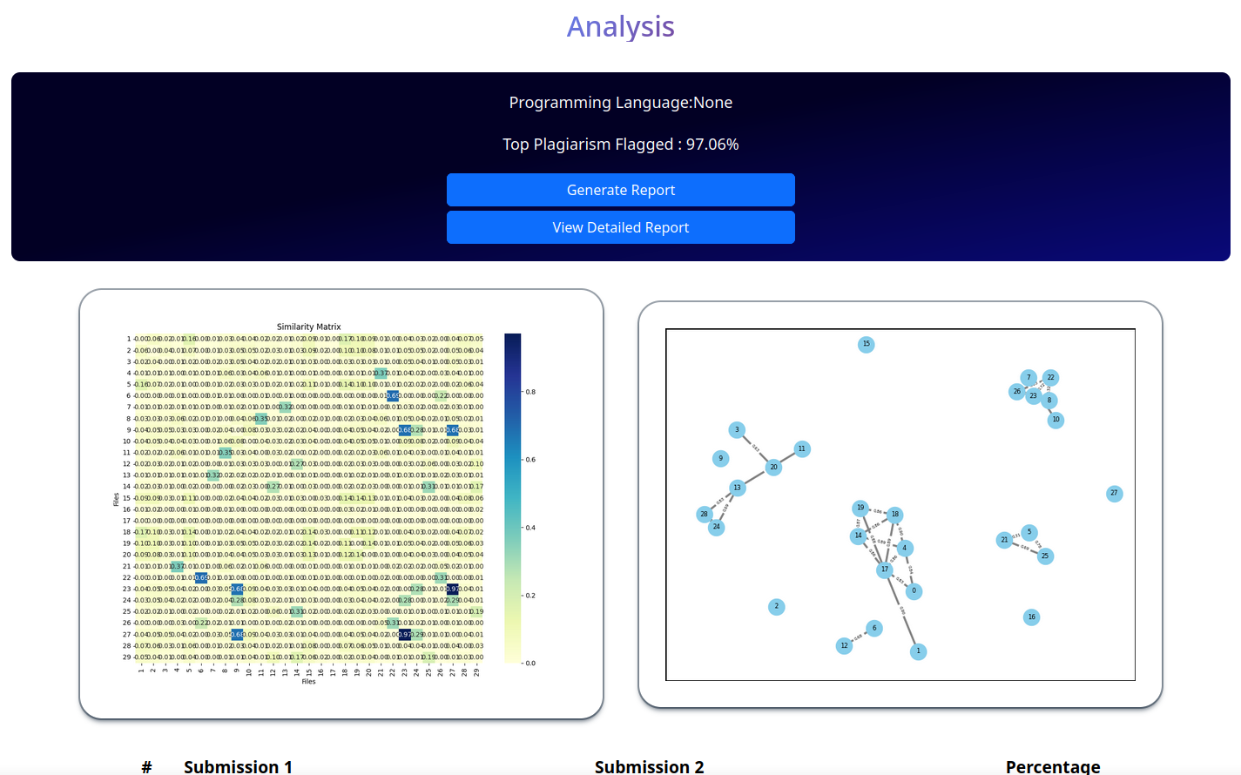
PLAGIARISM DETECTION AND REPORTING SYSTEM (PDRS)
UI Design and Functionality
COEP Technological University
A Unitary Public University of Govt. of Maharashtra
Formerly College of Engineering Pune

Slide 7
PLAGIARISM DETECTION AND REPORTING SYSTEM (PDRS)
Report Generation
We have taken major strides to enable easy identification of plagiarism once the corpus has been processed
Key visual aids are a heatmap correlation matrix, a cluster plot and 1:1 comparison between a pair of documents
These aids combined with a readily available comprehensive report on the dashboard enable the user to quickly identify and
COEP Technological University
A Unitary Public University of Govt. of Maharashtra
Formerly College of Engineering Pune

